Slide 1
#include<iostream>
#include<cmath>
#include<cstdlib>
#include<cctype>
using namespace std;
void main()
{
cout<<"abs(3.5): "<<abs(3.5)<<endl;
cout<<"abs(-3.5): "<<abs(-3.5)<<endl;
cout<<"ceil(59.76): "<<ceil(59.76)<<endl;
cout<<"ceil(-59.76): "<<ceil(-59.76)<<endl;
cout<<"exp(1) : "<<exp(1)<<endl;
cout<<"fabs(3.5): "<<fabs(3.5)<<endl;
cout<<"cos(0): "<<cos(0)<<endl;
cout<<"floor(40.8): "<<floor(40.8)<<endl;
cout<<"floor(-40.8): "<<floor(-40.8)<<endl;
cout<<"tolower(65): "<<tolower(65)<<endl;
cout<<"toupper(97) : "<<toupper(97)<<endl;
}

Slide 2
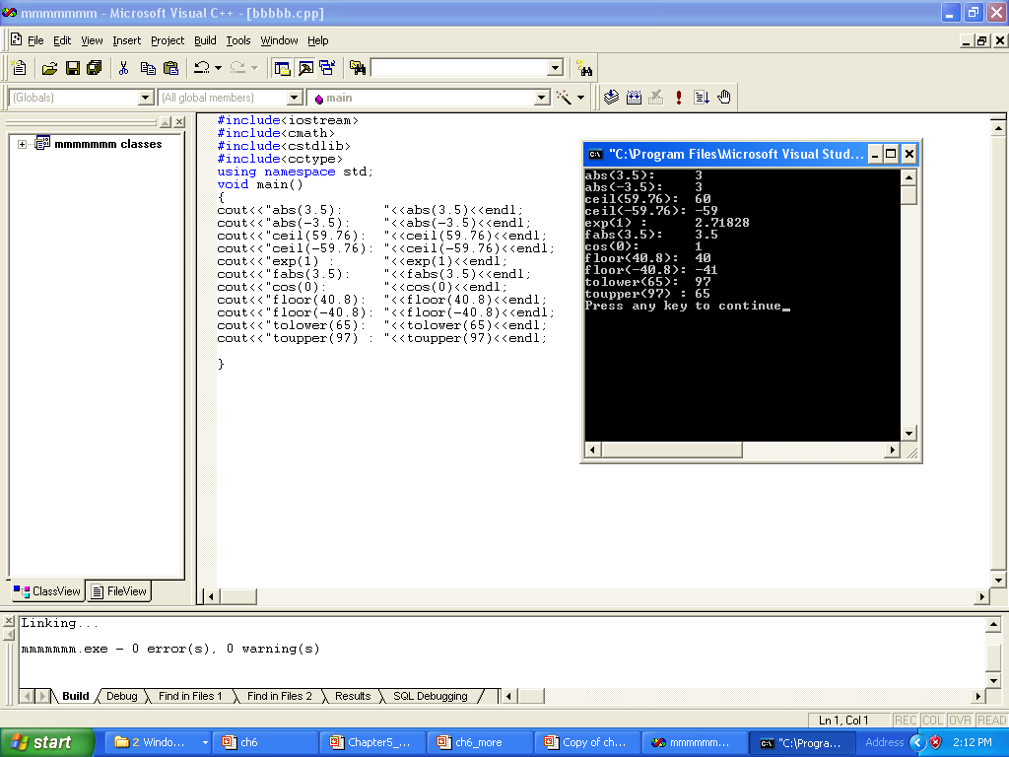

Slide 3
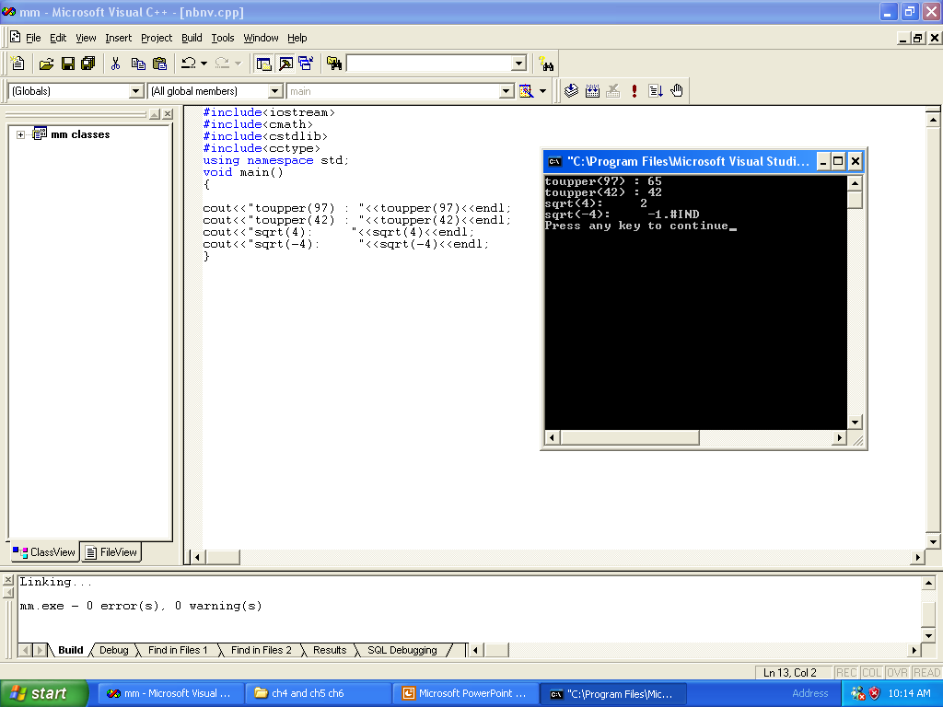

Slide 4
#include<iostream>
#include<cmath>
#include<cstdlib>
#include<cctype>
using namespace std;
void main()
{
cout<<"toupper(97) : "<<toupper(97)<<endl;
cout<<"toupper(42) : "<<toupper(42)<<endl;
cout<<"sqrt(4): "<<sqrt(4)<<endl;
cout<<"sqrt(-4): "<<sqrt(-4)<<endl;
}

Slide 5
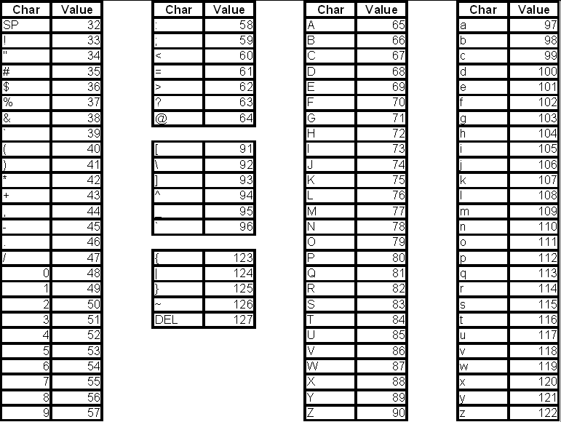

Slide 6
#include<iostream>
using namespace std;
int square( int m ); // function prototype
//it can be int square( int );
int main()
{
for ( int x = 1; x <= 10; x++ )
cout << square( x ) << " "; //calling statement x is actual parameter
cout << endl;
return 0;
}
// Function definition
int square( int y ) // Heading y is Formal Parameter
{
return y * y; // The return Statement
}

Slide 7
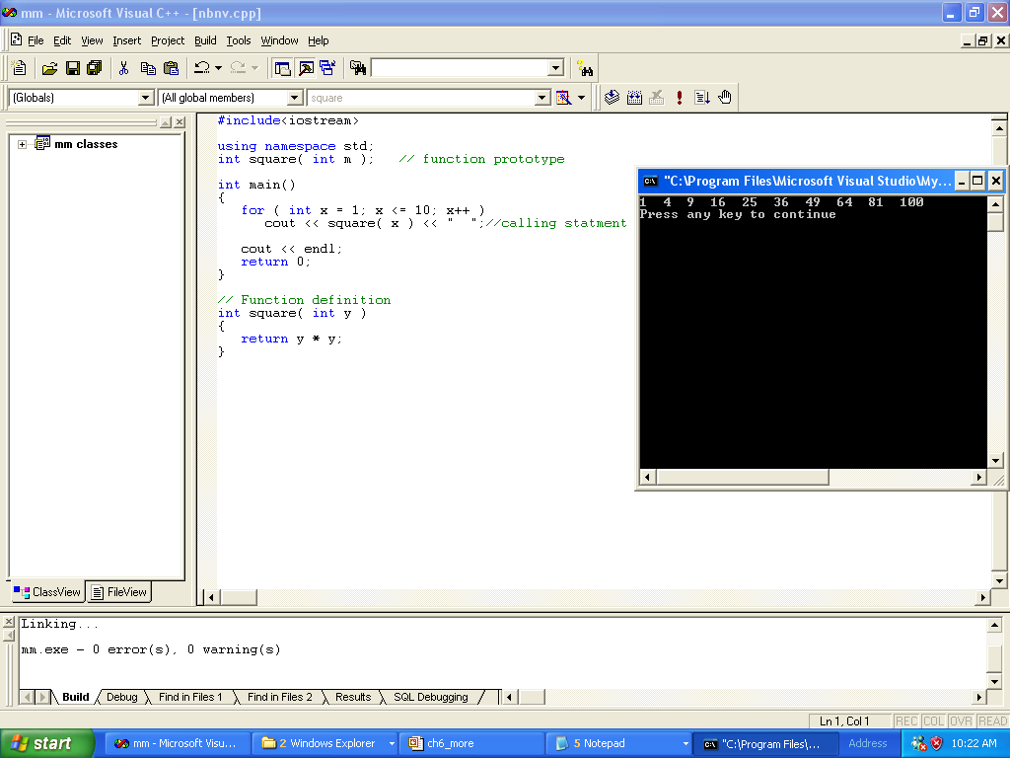

Slide 8
#include<iostream>
using namespace std;
int square( int ); // function prototype
int main()
{
for ( int x = 1; x <= 10; x++ )
cout << square( x ) << " ";
cout << endl;
return 0;
}
// Function definition
int square( int y )
{
return y * y;
}

Slide 9
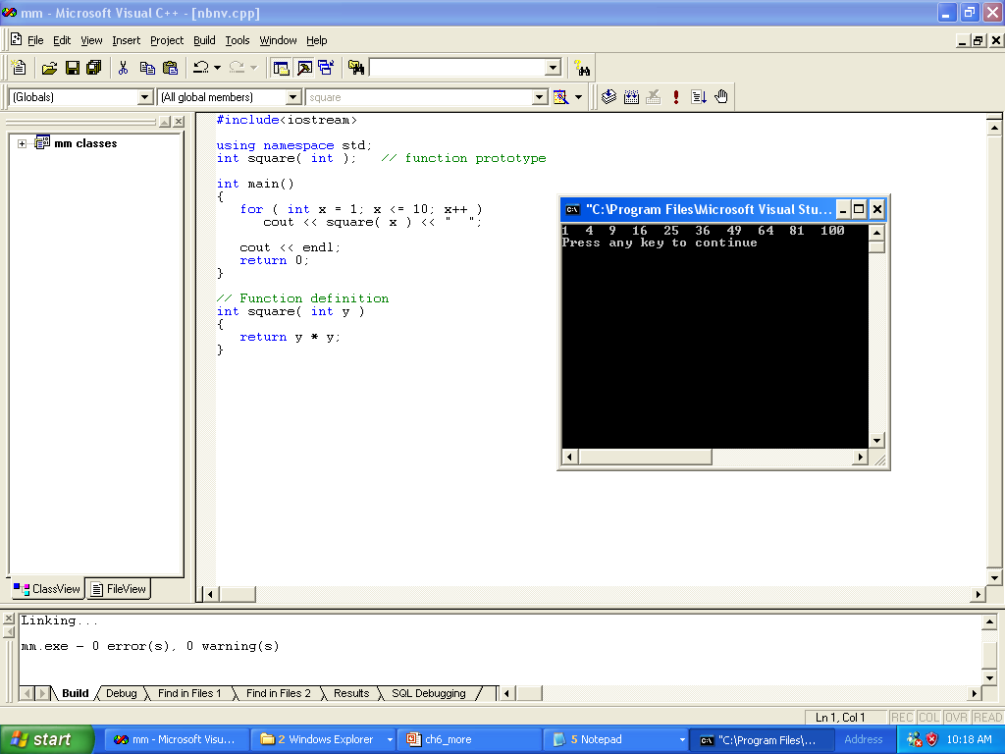

Slide 10
#include<iostream>
using namespace std;
int cube( int y ); // function prototype
int main()
{
int x;
for ( x = 1; x <= 10; x++ )
cout << cube( x ) << endl; //calling statement x is actual parameter
return 0;
}
// Function definition
int cube( int y ) // Heading y is Formal Parameter
{
return y * y * y;
}

Slide 11
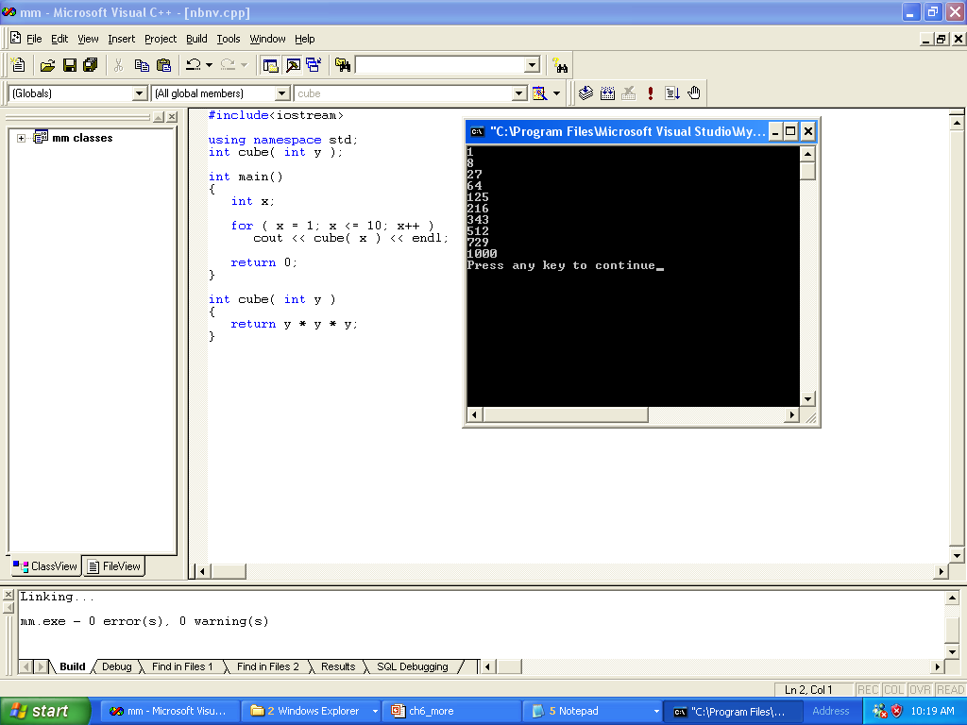

Slide 12
#include<iostream>
using namespace std;
int maximum( int, int, int ); // function prototype
int main()
{
int a, b, c;
cout << "Enter three integers: "<<endl;
cin >> a >> b >> c;
// a, b and c below are arguments (actual parameters) to
// the maximum function call
cout << "Maximum is: " << maximum( a, b, c ) << endl;
return 0;
}
// Function maximum definition
// x, y and z below are parameters ( formal parameters) to
// the maximum function definition
int maximum( int x, int y, int z )
{
int max = x;
if ( y > max )
max = y;
if ( z > max )
max = z;
return max;
}

Slide 13
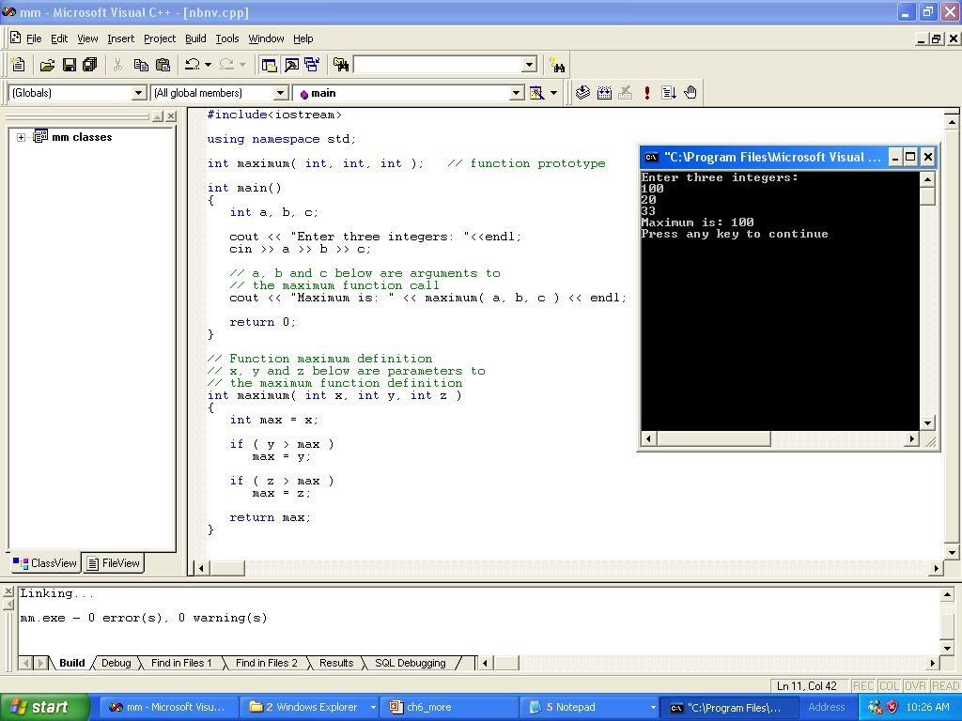

Slide 14
Programming Example

Slide 15
Programming Example
// Program: Largest
#include <iostream>
using namespace std;
double larger(double x, double y);
int main()
{
double num; //variable to hold the current number
double max; //variable to hold the larger number
int count; //loop control variable
cout << "Enter 10 numbers." << endl;
cin >> num; //Step 1
max = num; //Step 1
for (count = 1; count < 10; count++) //Step 2
{
cin >> num; //Step 2a
max = larger(max, num); //Step 2b
}
cout << "The largest number is " << max<< endl; //Step 3
return 0;
}//end main
double larger(double x, double y)
{
if (x >= y)
return x;
else
return y;
}

Slide 16
The return Statement

Slide 17
#include<iostream>
using namespace std;
int maximum( int, int, int ); // function prototype
int main()
{
int a, b, c;
cout << "Enter three integers: "<<endl;
cin >> a >> b >> c;
// a, b and c below are arguments (actual parameters) to
// the maximum function call
cout << "Maximum is: " << maximum( a, b, c ) << endl;
return 0;
}
// Function maximum definition
// x, y and z below are parameters ( formal parameters) to
// the maximum function definition
int maximum( int x, int y, int z )
{
int max = x;
return 0;
if ( y > max )
max = y;
if ( z > max )
max = z;
return max;
}

Slide 18
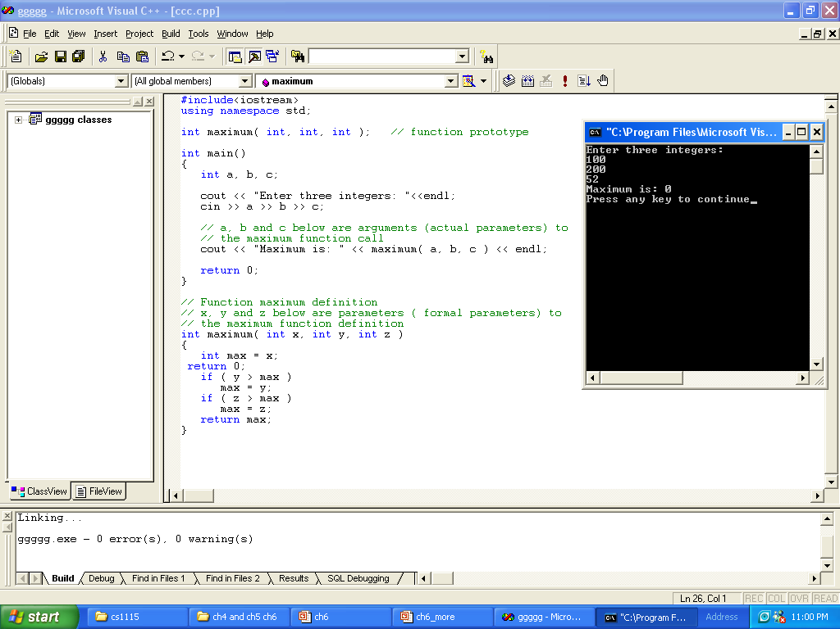

Slide 19
#include<iostream>
using namespace std;
int maximum( int, int, int ); // function prototype
int main()
{
int a, b, c;
return 0;
cout << "Enter three integers: "<<endl;
cin >> a >> b >> c;
// a, b and c below are arguments (actual parameters) to
// the maximum function call
cout << "Maximum is: " << maximum( a, b, c ) << endl;
return 0;
}
// Function maximum definition
// x, y and z below are parameters ( formal parameters) to
// the maximum function definition
int maximum( int x, int y, int z )
{
int max = x;
if ( y > max )
max = y;
if ( z > max )
max = z;
return max;
}

Slide 20
